Slide 1

Vehicle insurance App
submitted by:
mohammad Mubeen

Slide 2
Index:
INTRODUCTION
PURPOSE
FEATURES
BackEnd
TECHNOLOGIES
BENEFITS
CONCLUSION

Slide 3
INTRODUCTION:
In today's fast-paced world, managing vehicle insurance efficiently is crucial for vehicle owners. With the advent of smartphones, developing a mobile application that streamlines the process of managing vehicle insurance has become an essential solution. This project aims to create a comprehensive Vehicle Insurance App using Android Studio .

Slide 4
PURPOSE:
The primary purpose of the Vehicle Insurance App is to provide users with a convenient, user-friendly platform to manage their vehicle insurance policies. This app will enable users to:
View and manage their insurance policies.
File claims.
View all claims
Connect with insurance providers for support.

Slide 5
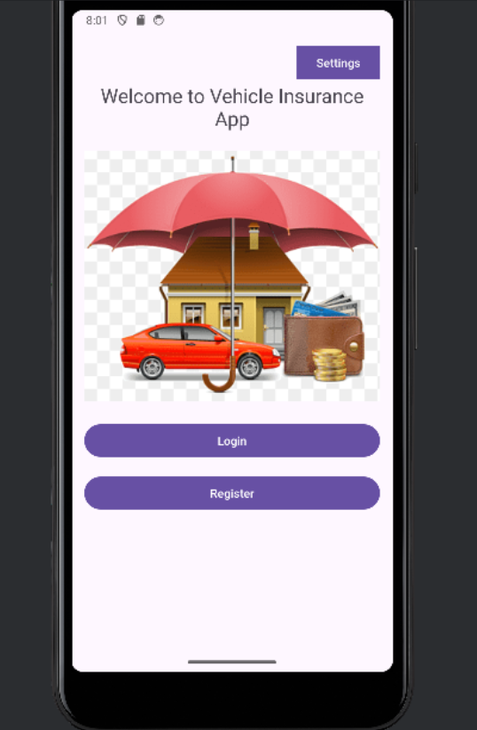
Features:
Home page:
Home page of the vehicle insurance app which contains login and register.

Slide 6
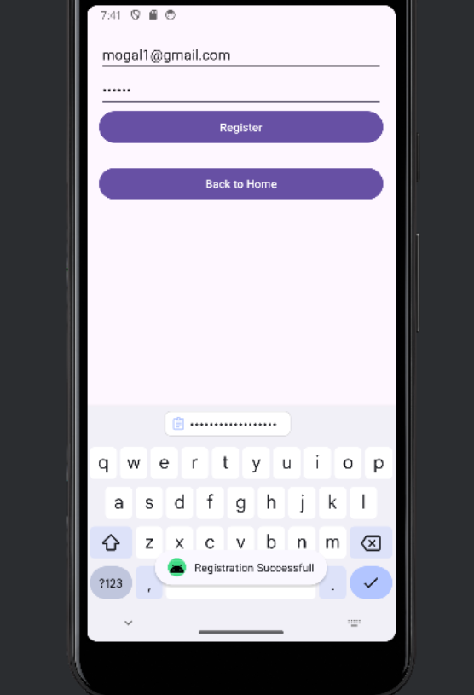
User Registration :
Secure user authentication using email and password.
When u click on register button it displays as “Registration Successful”.

Slide 7
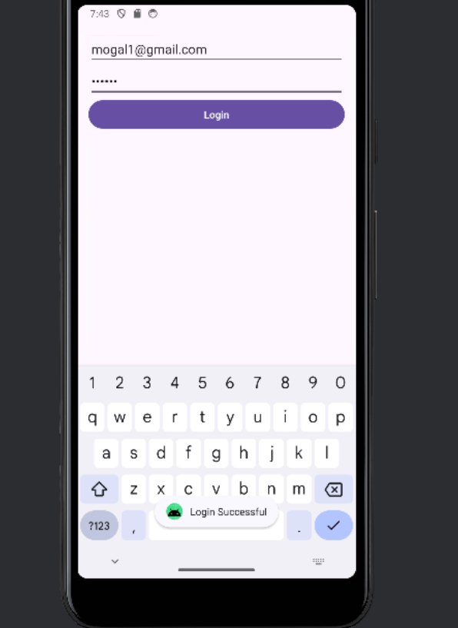
User Login:
Login Successful:
Whenever you enter a precise email and password which you provide at your registration then only it displays “Login Successful”.

Slide 8
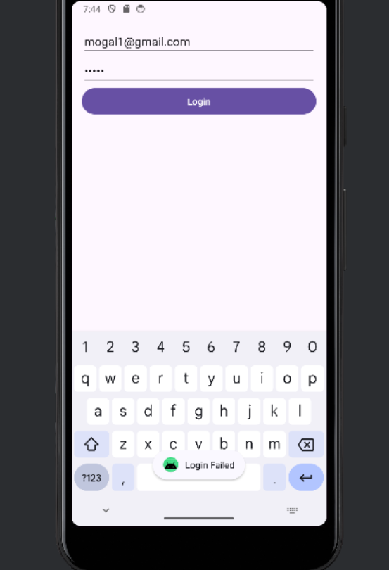
Login failure:
Whenever you not enter a precise email and password which you provide at your registration then it displays “Login Failed”.

Slide 9
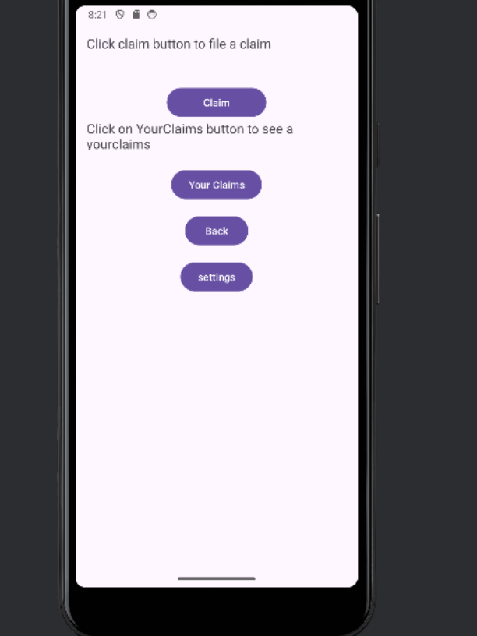
Claim page:
When the login successful it redirect to claim page which contains claim button ,Your claims button.

Slide 10
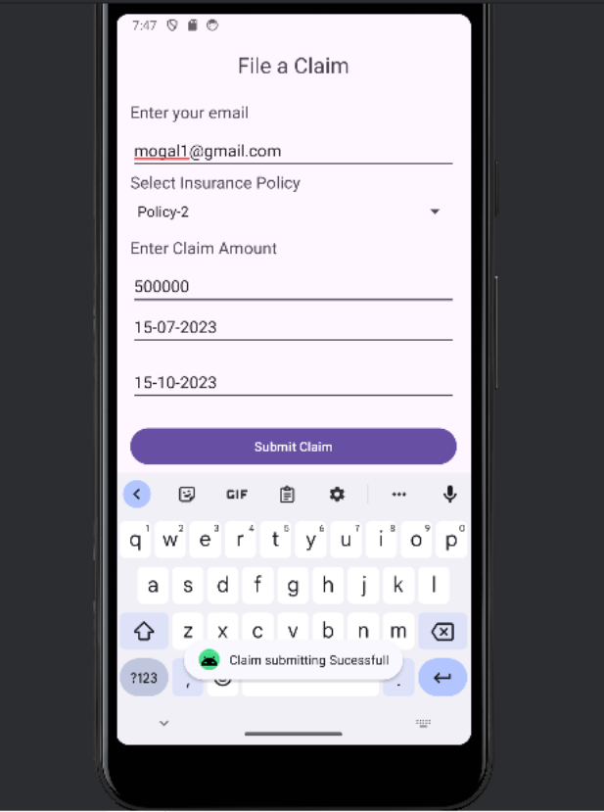
Claim Details Page:
When you click on claim button it redirects to claim details page which contains email,insurance policy type,claim amount,start and end date of the policy.

Slide 11
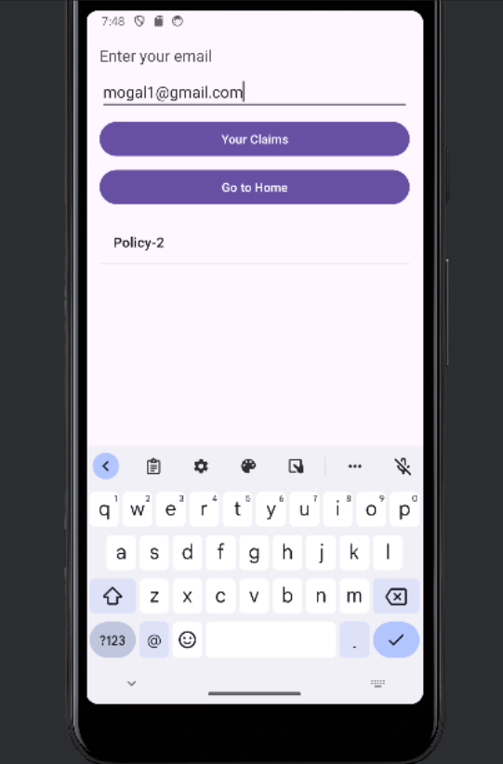
Claims History Page:
If you want to know your claims history enter your email then just click on “Your Claims” button,it displays all your claims .

Slide 12
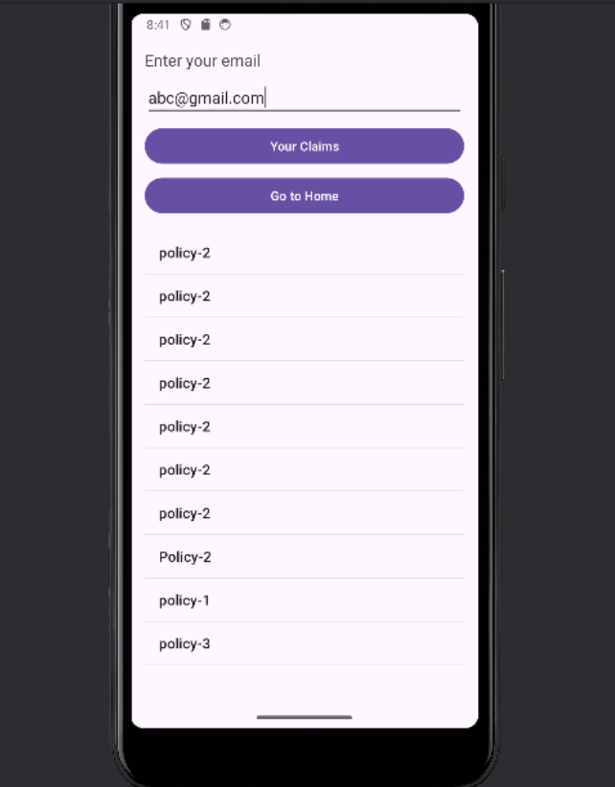
If you have already registered and having more number of insurance policies then it will display all your claims.

Slide 13
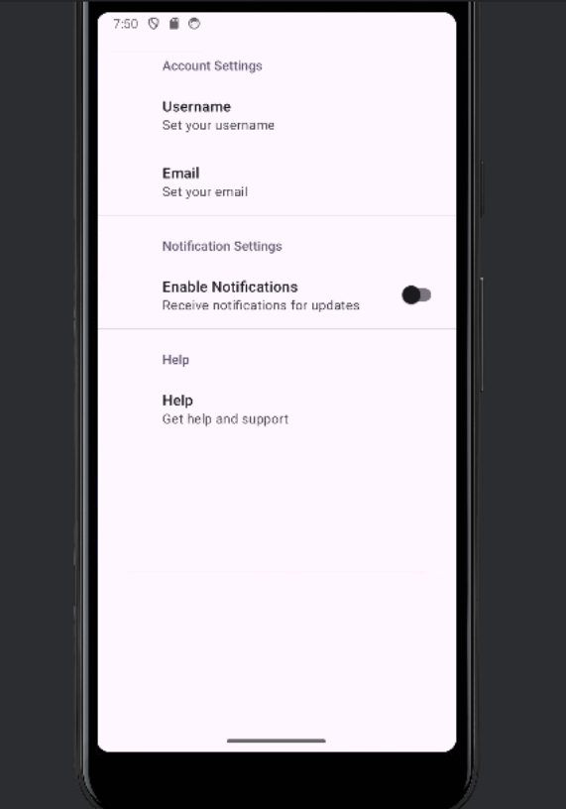
Settings Page:
When you click on “Settings” menu on Home Page it will display setting page which contain AccountSettings, Notifications and Help.

Slide 14
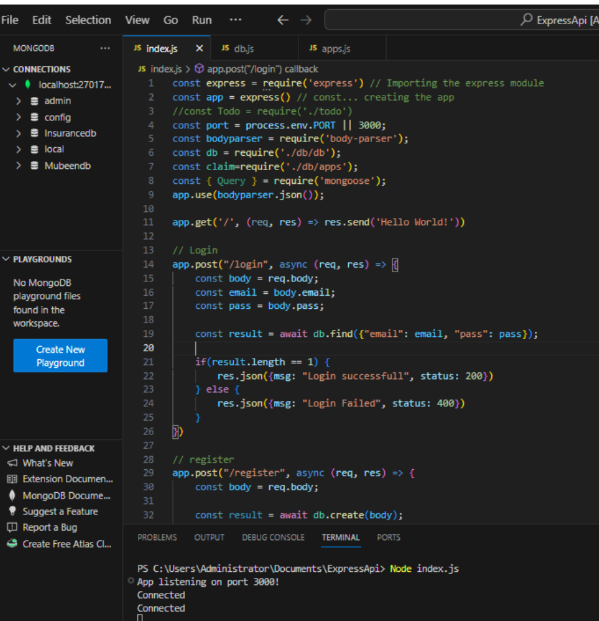
BackEnd:
Database Connection:
Whenever we connect with the database with a port number, it displays in terminal as “connected “ .

Slide 15
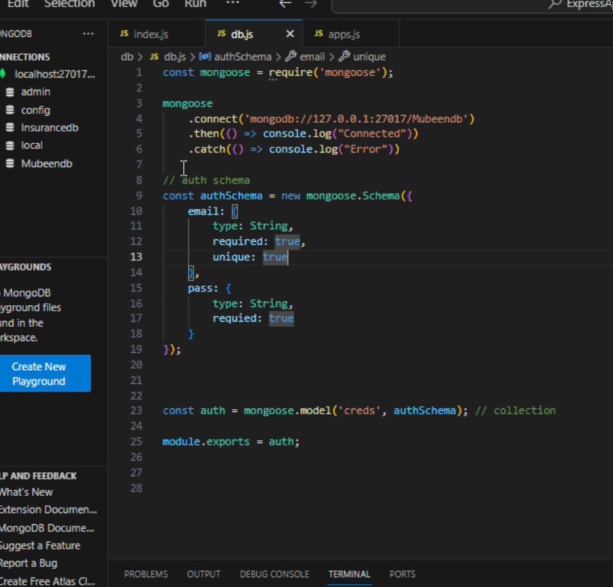
Here , I created a collection ‘”creds” for storing email and password of the Registration and login pages.

Slide 16
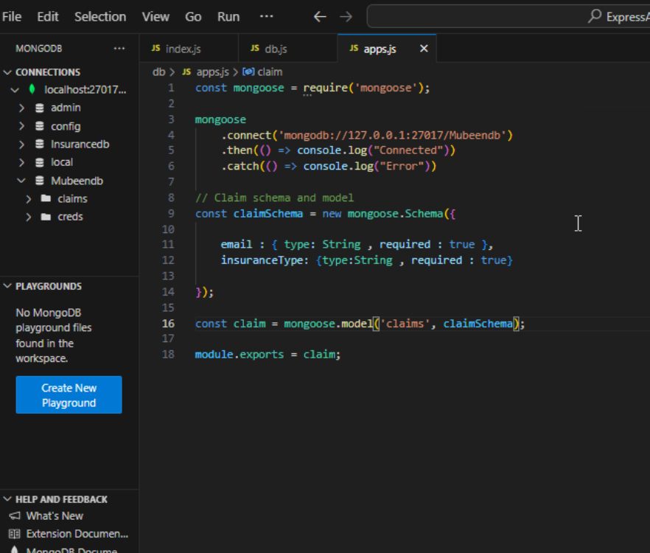
Here , I created a collection ‘”claims” for storing insurance policy of the claims and all claims pages.

Slide 17
Technologies:
Android Studio: The primary development tool for creating the app, utilizing Java/Kotlin for coding.
Mongodb: For backend support including authentication, database.
Retrofit: For handling network requests and API interactions.

Slide 18
Benefits:
The Vehicle Insurance App offers numerous benefits, including:
Convenience: Users can manage all aspects of their vehicle insurance from their mobile device.
Efficiency: Automated easy claim submissions save time and reduce hassle.
Security: Secure authentication and data management ensure user information is protected.

Slide 19
Conclusion:
The Vehicle Insurance App using Android Studio is designed to revolutionize the way users manage their vehicle insurance. By leveraging modern mobile technology, the app provides a seamless, efficient, and secure platform for all insurance-related activities. This project not only enhances user experience but also simplifies the complex processes associated with vehicle insurance management.
Notes:
The Vehicle Insurance App using Android Studio is designed to revolutionize the way users manage their vehicle insurance. By leveraging modern mobile technology, the app provides a seamless, efficient, and secure platform for all insurance-related activities. This project not only enhances user experience but also simplifies the complex processes associated with vehicle insurance management.
4o

Slide 20


